Slide 1
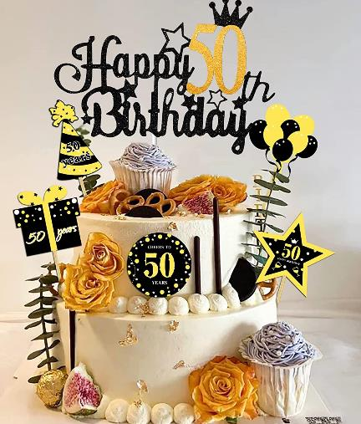
IFC at 50!

Slide 2
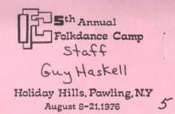
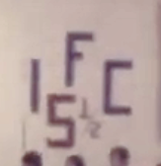
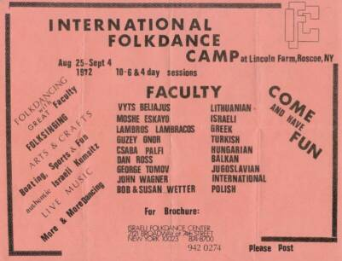
1976
11 days!
14 days!
#1: 1972
1975-1976

Slide 3
IFC: Through the years
IFCs: 1972 – 1986
IFC Reunions: 2005 – 2013
[Steve & Susan and Morley & Monique were at the first Reunion!]
IFC Revivals: 2018 – 2022 and beyond

Slide 4
IFC: How'd it start?
Moshe said he had the idea for an international camp after teaching at Stockton Folkdance Camp in 1971

Slide 5
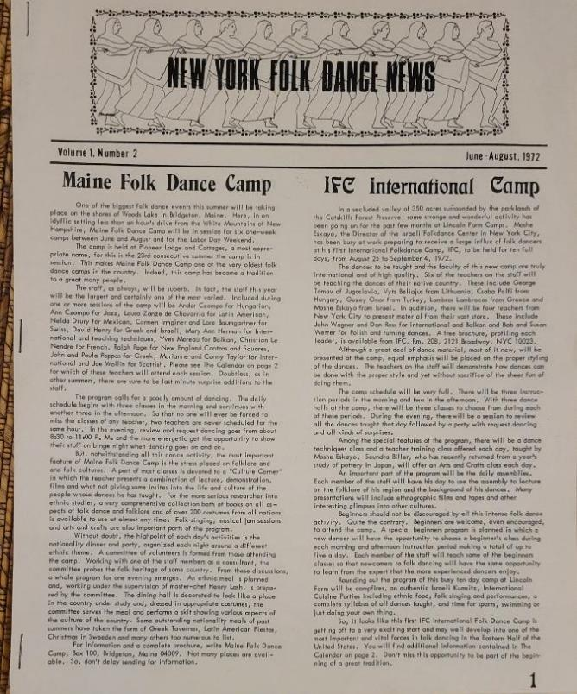
IFC 1972
Some strange and wonderful activity has been going on for the past few months at Lincoln Farm Camps. Moshe Eskayo … has been busy preparing for a large influx of folk dancers at his first IFC camp.
It looks like this first IFC International Folk Dance Camp is getting off to a very exciting start and may well develop into one of the most important and vital forces in folk dancing in the Eastern Half of the United States.
Don't miss this opportunity to be part of the beginning of a great tradition.

Slide 6
IFC: In the news #2
Last week, Fusae hosted a tribute to Atanas. She said she first met him at IFC in 1979. "At first sight, I invited him to Japan and the rest is history"
Countless other relationships (professional and recreational) were created at IFC

Slide 7
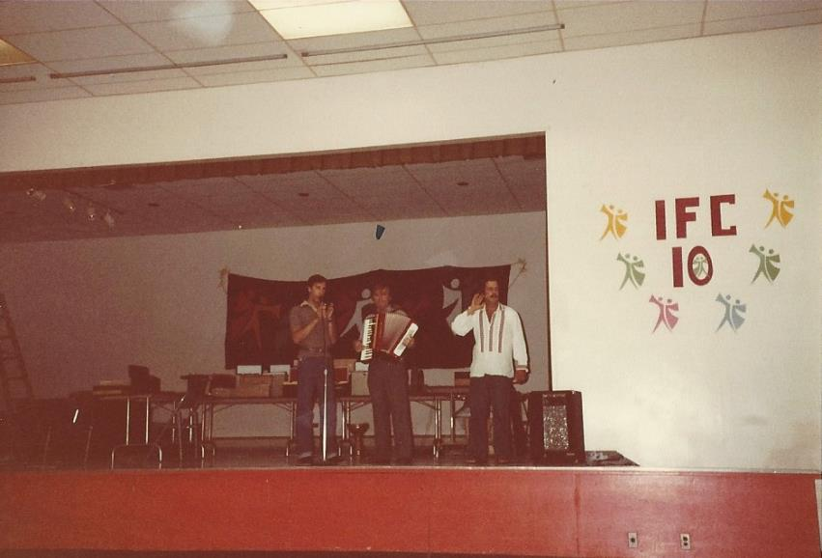
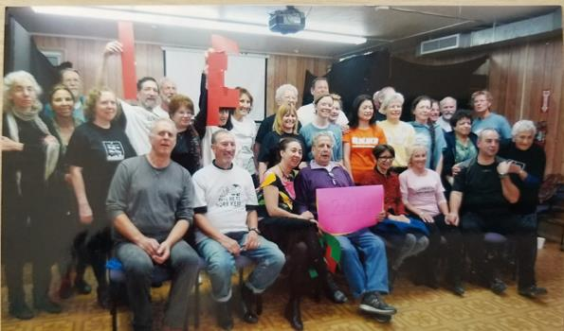
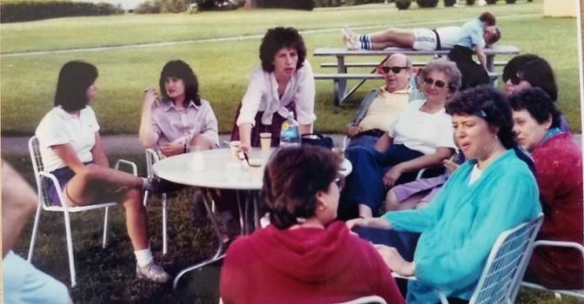
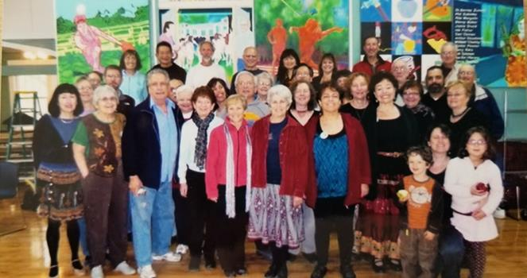
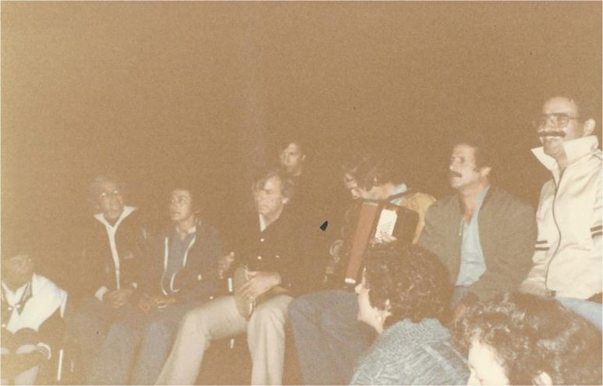
IFC: Some memories
Atanas Kolarovski, David Vinski with Moshe 1981
2012
Steve & Susy, David, Cristian & Sonia: 2012
IFC #10 1981

Slide 8
IFC: More memories
IFC Through the Years and Remembrances around the room

Slide 9
IFC: Roll the videos!

Slide 10
Shashana
Moshe
Shalosh!

Slide 11
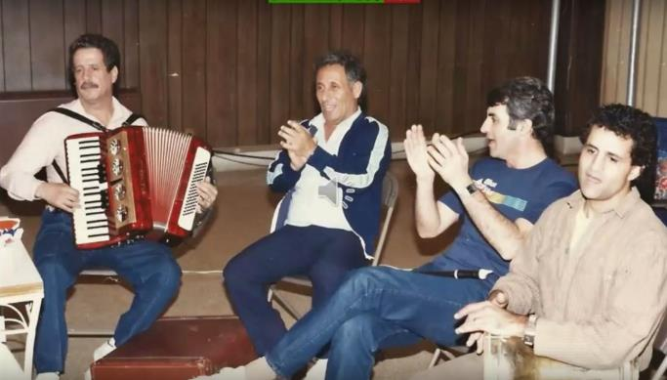
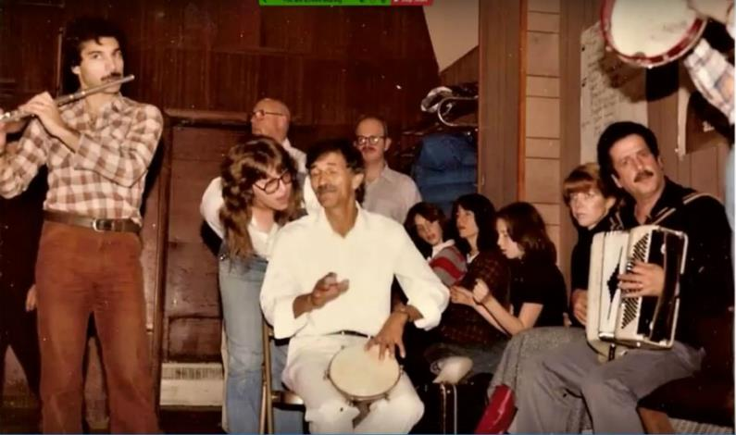
Moshe the musician

Slide 12
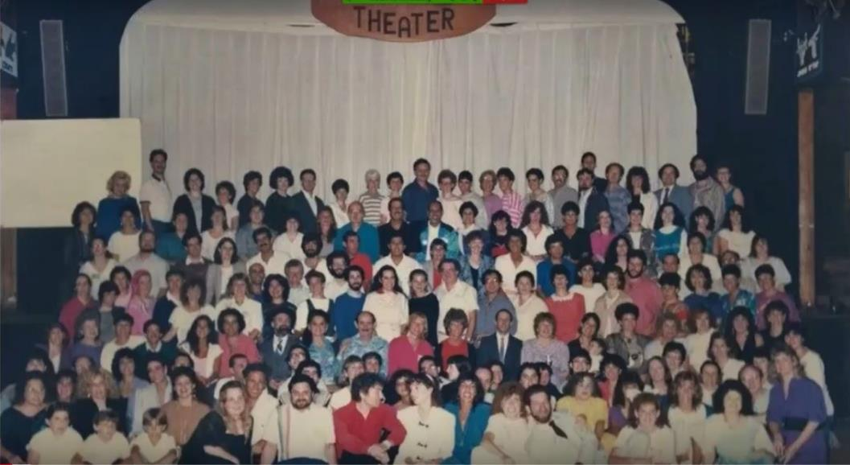
Moshe the camp director

Slide 13
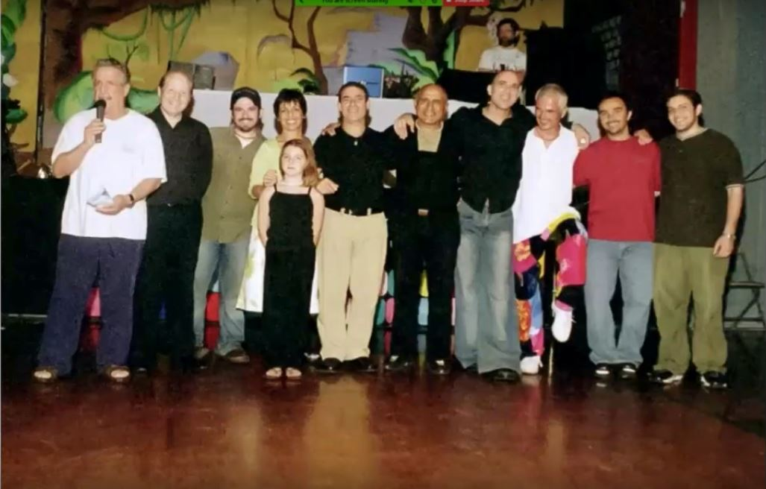

Slide 14
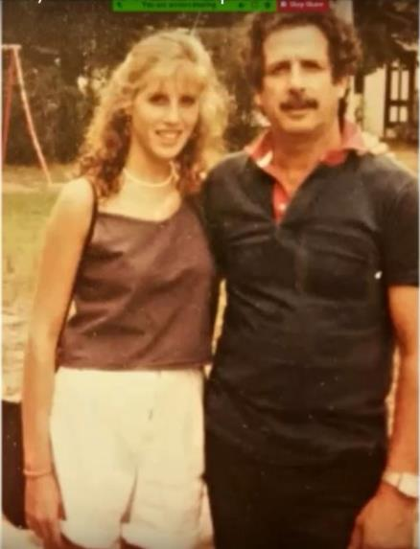
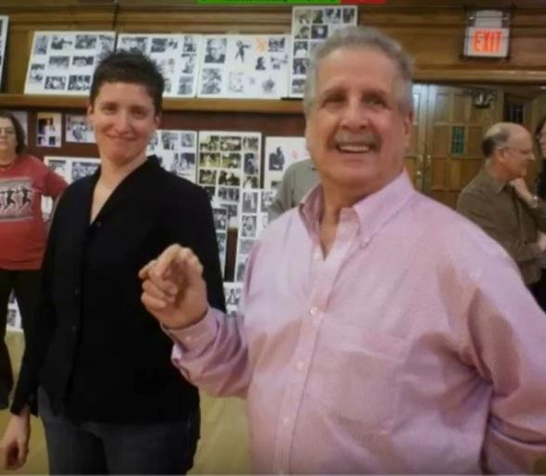
Moshe the father

Slide 15
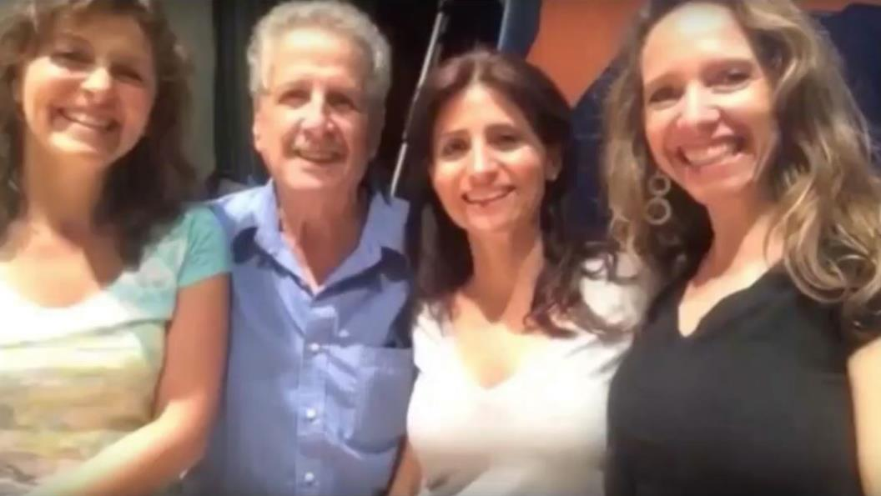
Moshe the consummate host

Slide 16
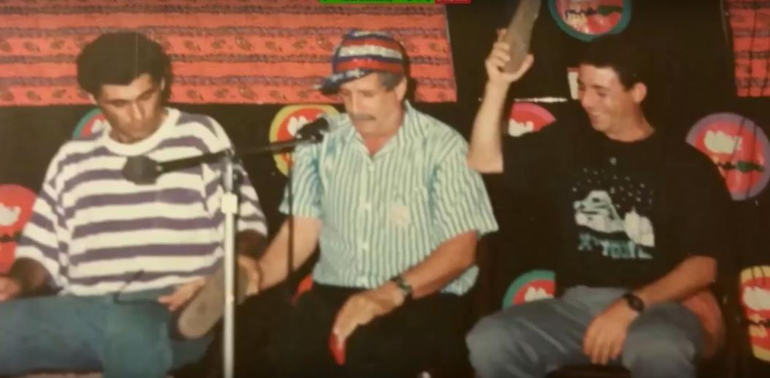
Moshe the showman

Slide 17
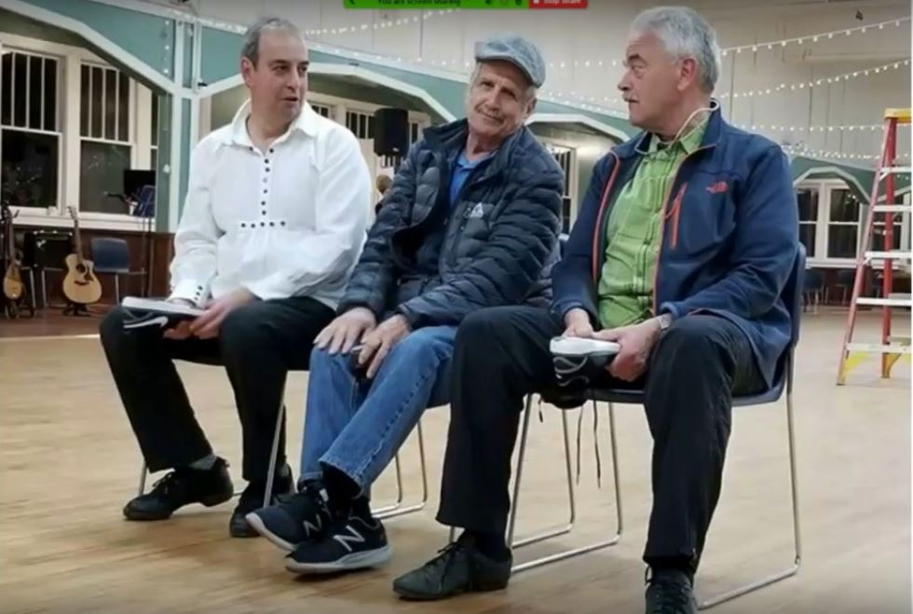

Slide 18
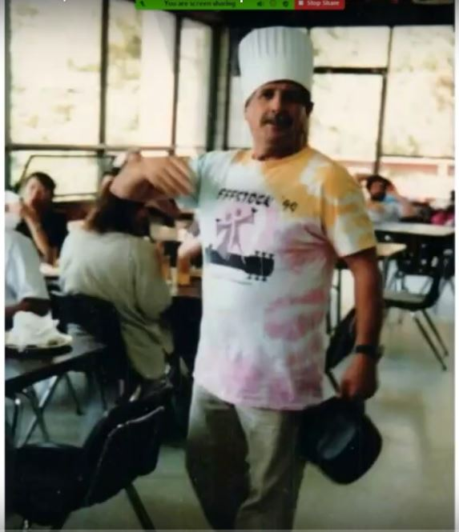
Moshe the chef

Slide 19
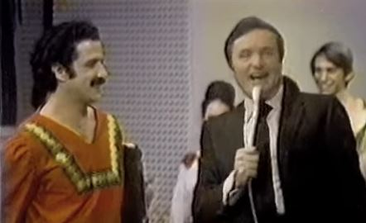
Moshe the TV star

Slide 20
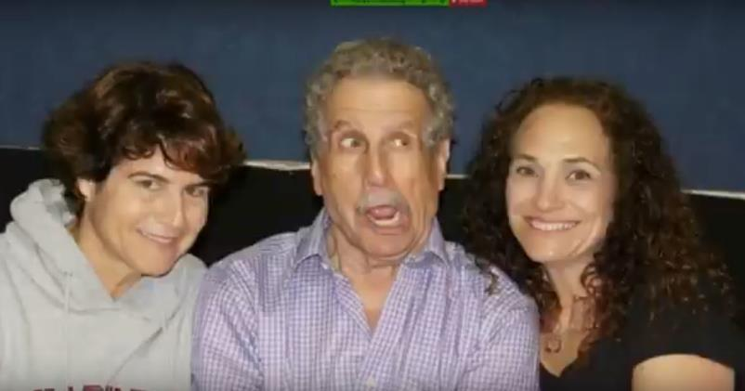
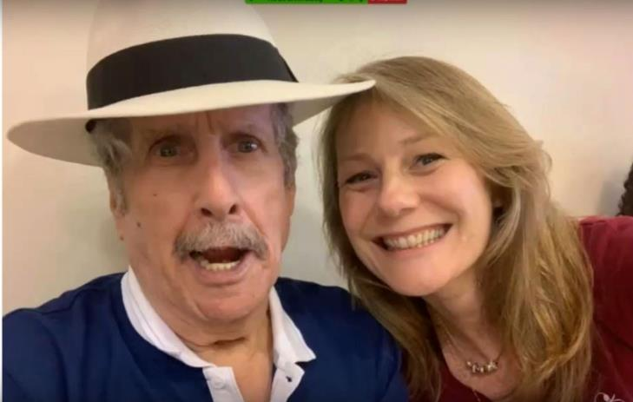
Moshe the clown

Slide 21
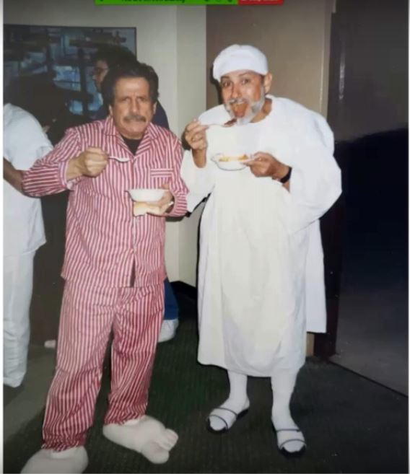
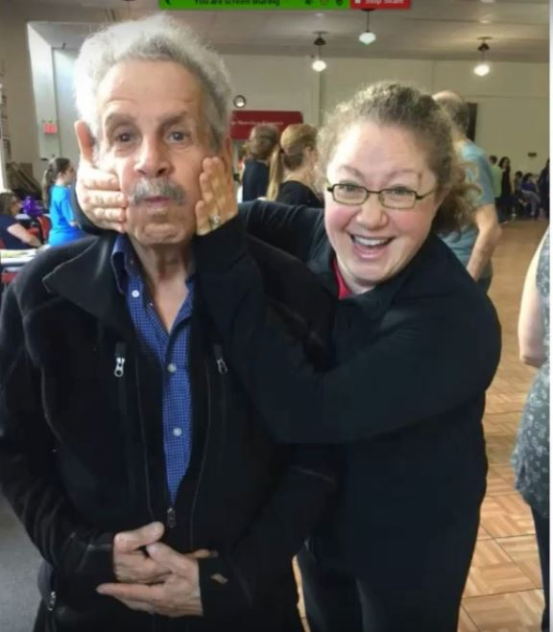

Slide 22
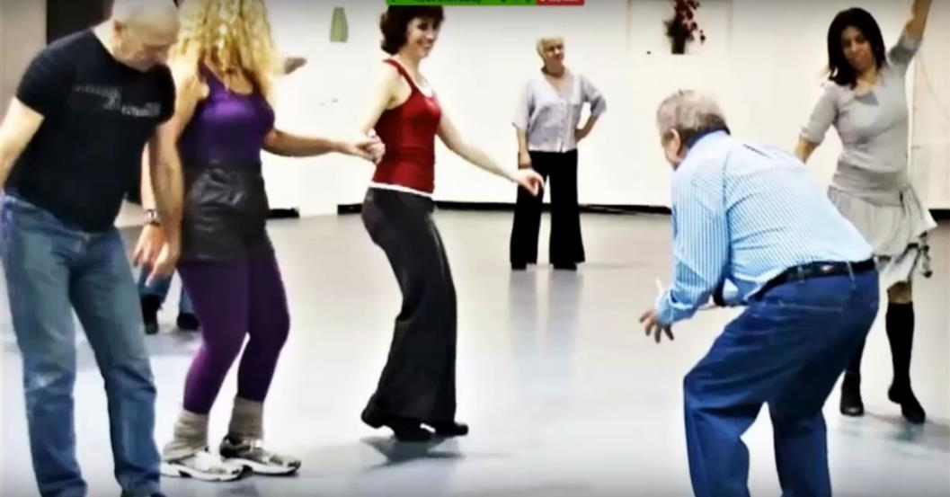
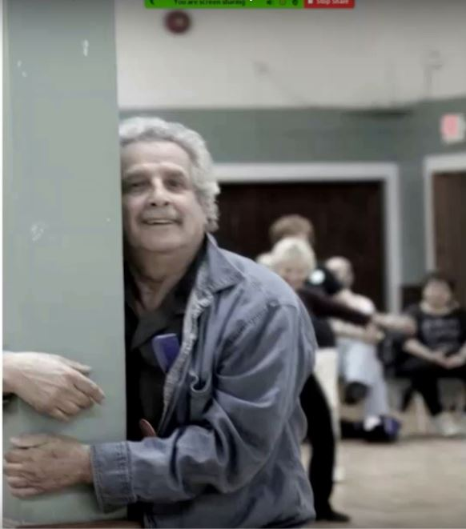

Slide 23
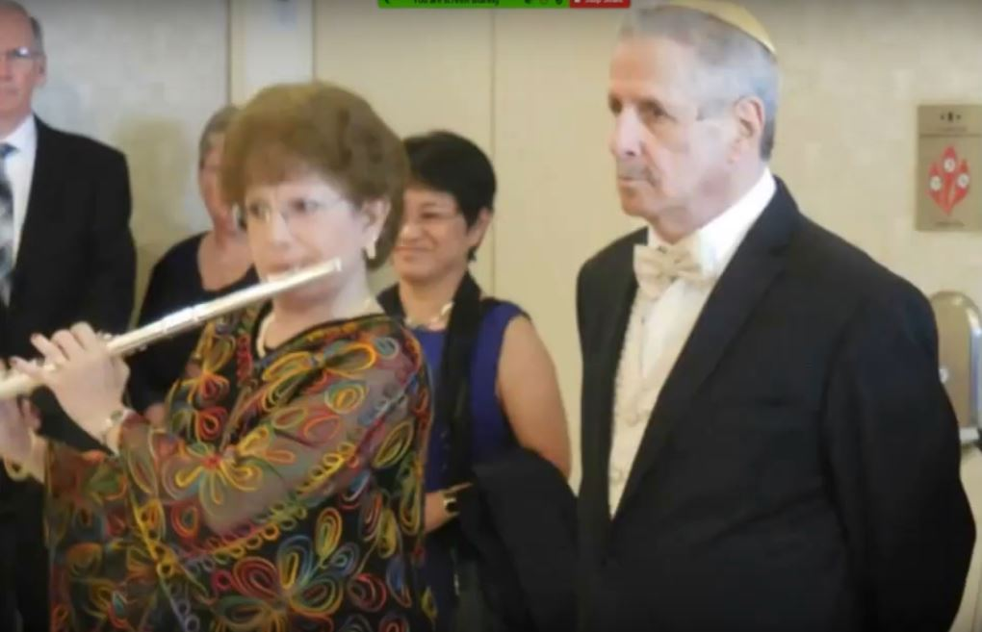
Moshe as almost never seen

Slide 24
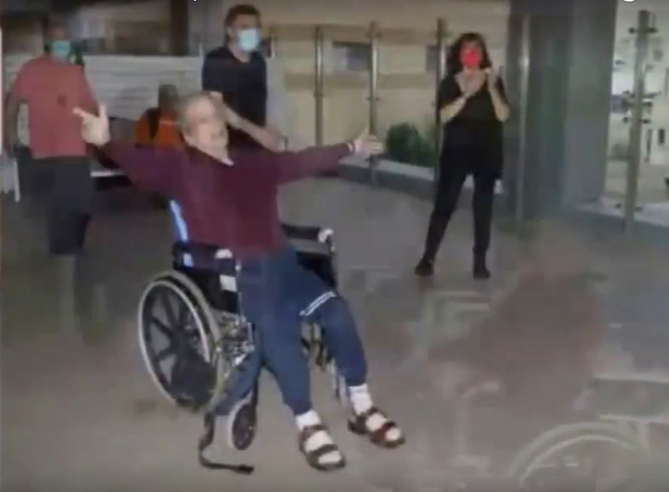
In nursing home Nov 2020

Slide 25
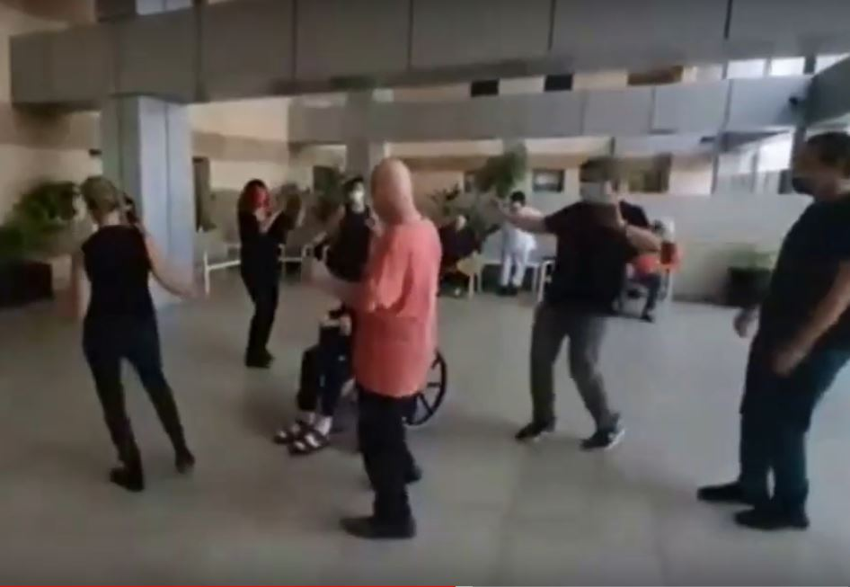

Slide 26
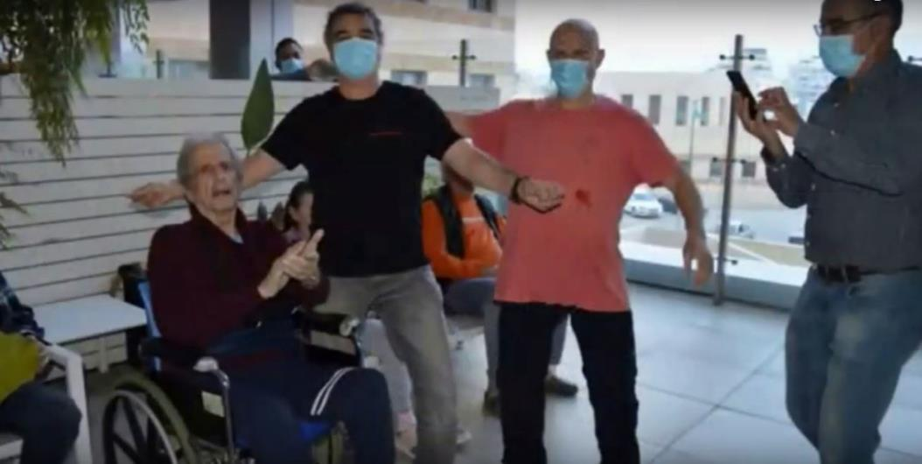

Slide 27
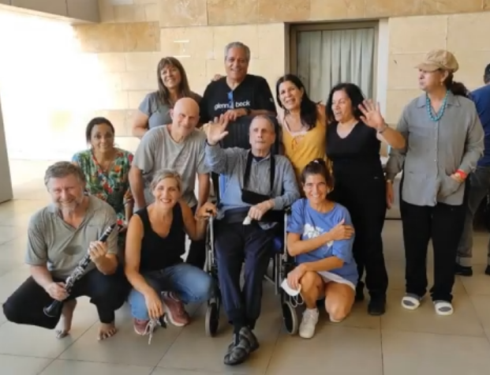

Slide 28
Roll the video tape!
+ tributes and remembrances around the room

Slide 29
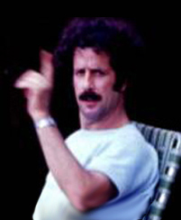
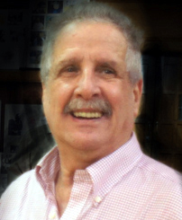
Moshe Eskayo
11/30/1931 - 4/5/2022

Slide 30
He will be in our hearts forever

Slide 31
In honor of Moshe,
let's dance a couple of classics

